Slide 1
Design patterns

Slide 2
What & Why
proven solutions to recurring design problems
Common language
Best practice from others experience

Slide 3
Types
Creational patterns
Structural patterns
Behavioral patterns

Slide 4
Creational
Factory method
Abstract Factory
Singleton
Builder
Prototype

Slide 5
Structural
Adapter
Bridge
Composite
Decorator
Facade
Flyweight
Proxy

Slide 6
Behavioral
Chain of Responsibility
Command
Interpreter
Iterator
Mediator
Memento
Observer
State
Strategy
Template
Visitor

Slide 7
Design Principles
“Separate what varies from what remains constant”
“Prefer composition over inheritance”
“Program to interfaces over implementation”

Slide 8
problem
Implement a dictionary where the performance of search function can be configurable
Add functionality
  Search should be fast and can take more memory/cpu in a high end machine
  Search can be slow but should take less memory/cpu in a low end machine.

Slide 9
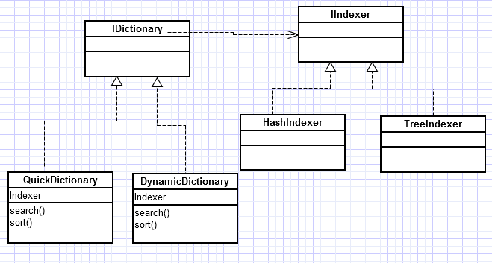
Strategy Pattern
Defines a set of algorithms
Makes them interchangeable
clients have the option to select
Comparator from java is one example of strategy

Slide 10
Problem
A bank software for maintaining Account
Interfaces
  ATM
  Online
  Manual
Design Principle : “Strive for loose coupling between objects that interact”

Slide 11
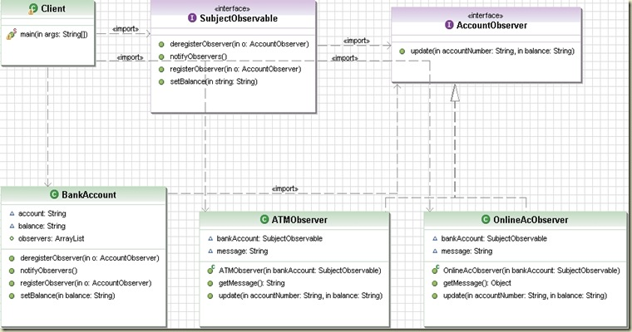
Observer Pattern:
One object’s state changes need to notify all its dependents
Java has in-built support check Observer/Observable

Slide 12
Problem
Implement a Juice maker machine, which can make juice with following ingredients
  Water
  Milk
  Orange/Lime
Design Principle: ” open – closed “

Slide 13
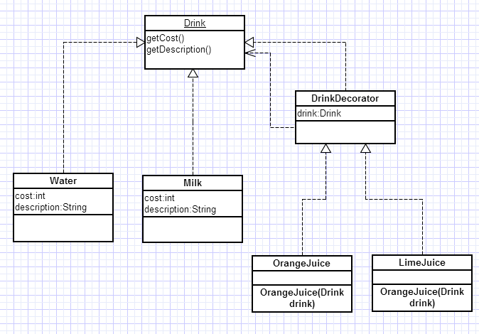
Decorator
attaches additional responsibilities to an object dynamically,Collections

Slide 14
Problem
Implement a computer shop which can create
A computer based on what brand of computer a client wants.
Design Principle “loose coupling, separate what changes from what is constant“

Slide 15
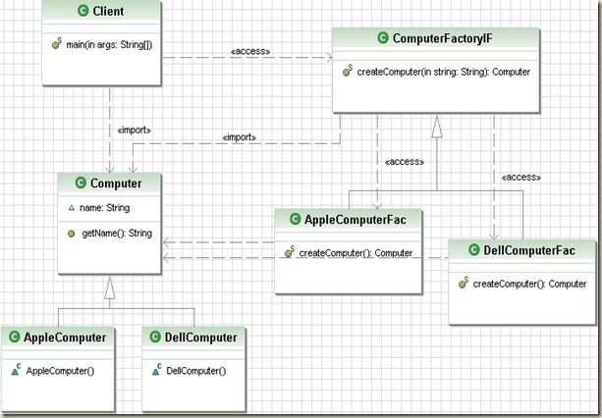
Factory Method
Provides an interface for creating an object
Without knowing concrete classes, DI

Slide 16
Problem
Implement a computer assembler which can assemble
A computer by making use of different parts
How can it be implemented ?
Design Principle “loose coupling, separate what changes from what is constant“

Slide 17
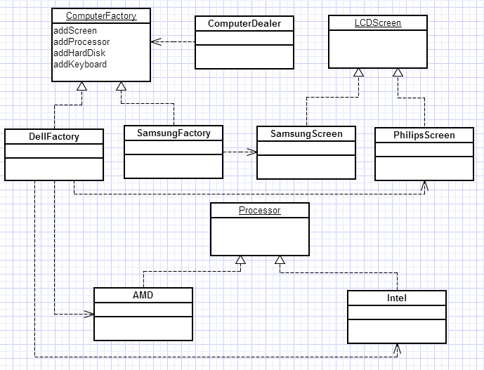
Abstract Factory
Provides an interface for creating family of objects
Encapsulate object creation and more loosely coupled

Slide 18
Problem
You need to have only one instance of a class.
And one access point
Across threads

Slide 19
Singleton
Classic implementation
Thread safe
Double check implementation

Slide 20
Classic Singleton
class SingleTon {
Private static SingleTon instance;
private SingleTon() {
}
public static SingleTon getInstance() {
if (instance == null) {
instance = new SingleTon();
}
return instance;
}

Slide 21
Double Check Singleton
public static DoubleCheckSingleton getInstance()
throws InterruptedException {
if (instance == null) {
synchronized (DoubleCheckSingleton.class) {
if (instance == null) {
instance = new DoubleCheckSingleton();
}
}
}
return instance;
}

Slide 22
Lazy Singleton
static private LazySafeSingleton instance;
private LazySafeSingleton() {
}
public static synchronized LazySafeSingleton getInstance() {
if (instance == null) {
instance = new LazySafeSingleton();
}
return instance;
}

Slide 23
Eager Singleton
public class EagerSingleton implements Cloneable,Serializable {
private static final long serialVersionUID = -795937965346649942L;
private static EagerSingleton instance = new EagerSingleton();
public static synchronized EagerSingleton getInstance() {
return instance;
}
@Override
public Object clone() throws CloneNotSupportedException {
throw new CloneNotSupportedException();
}
public Object readResolve() throws ObjectStreamException{
return getInstance();
}

Slide 24
Problem
Decouple invoker from the receiver
Encapsulation of the invocation

Slide 25
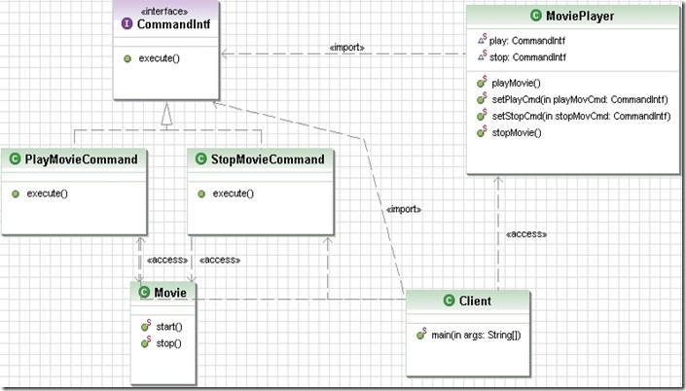
Command Pattern

Slide 26
Problem
A Client who has fixed his interfaces and wont change
A Service which has interfaces implemented and wont change
How do we handle this ?

Slide 27
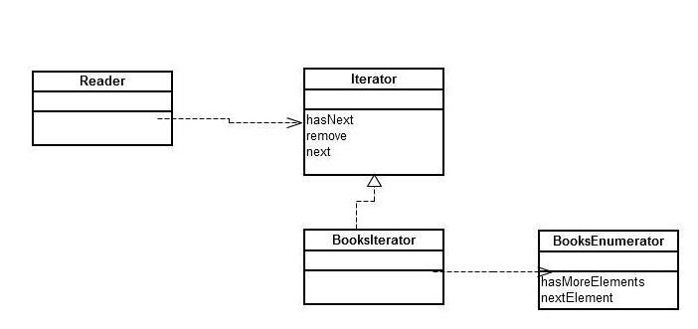
Adapter Pattern
Converts an interface of a class into what a client expects

Slide 28
Problem
You have to build a website like makemytrip
Interact with hotels
Interact with travel agencies
Collect money from client
“Design Principle- principle of least knowledge, talk only to your immediate friends”

Slide 29
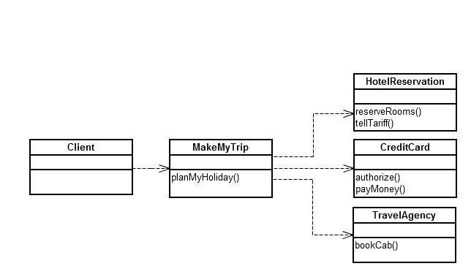
Facade
Provides a unified interface to a set of interfaces

Slide 30
Problem
implement a Drink Maker with following steps
    Add Water
    Add Fruit
    Add ice
Design Principle : "Don't call us, we will call you"

Slide 31
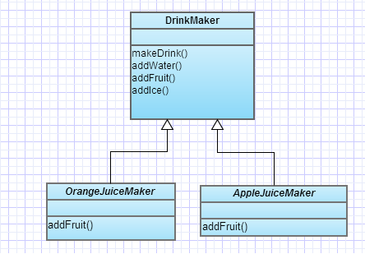
Template Method
Defines the algorithm , and defers some implementation to the sub classes, Comparable and sort

Slide 32
Problem
Iterating over an Aggregation
how to iterate all the employees in a company

Slide 33
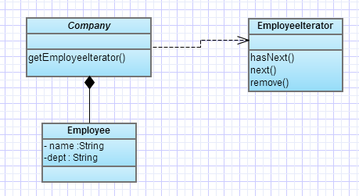
Iterator
single responsibility,
simplifies aggregation
does not expose implementation of aggregation

Slide 34
Problem
Implement a Mobile class which has the following states
LowBattery
  Makecall,charge
FullBattery
  Makecall,charge
ChargingBattery
  Charge,makecall

Slide 35
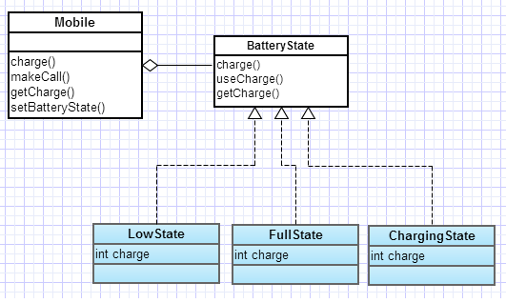
State Design Pattern
Mobile State
It allows to change the behavior of the object when the state of an object changes
behavior changes when the state changes , and the state transition is managed by the states.

Slide 36
Problem
You have to control access to an expensive object / which is remote

Slide 37
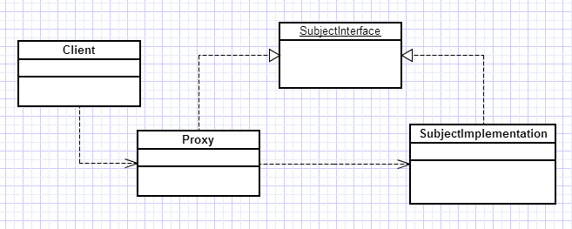
Proxy
Wraps another object to Control access
Hide information about the real object
Can do optimization

Slide 38
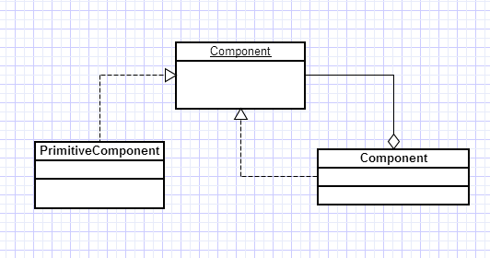
Composite Design Pattern
Importance of composite pattern is, the group of objects should be treated similarly as a single object.

Slide 39
Problem
Build a computer with cpu,ram,keyboard and monitor then add accessories like
speakers, webcam, mouse etc.

Slide 40
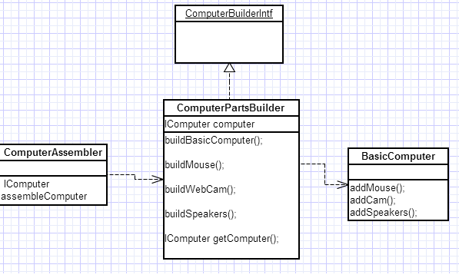
Builder Pattern
To create a complex object
controlled by another class director
Build an object step by step

Slide 41
Problem
Implement a football game logic of computer
Which has to play game based on the following rules
  If the ball is with Forward
    try to attack
  if he misses
    Pass to the mid fields
  If he misses
    Pass to the defender
  If he misses
    Pass to the goal keeper
  If he misses
    It a goal

Slide 42
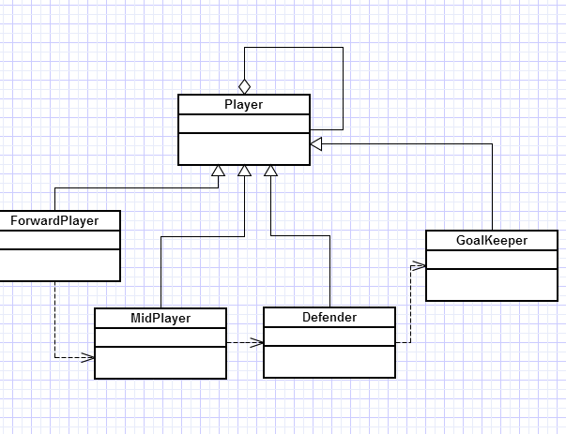
Chain of Responsibility
Sender will not know which object in the chain will serve its request.
Every node in chain will have the responsibility to decide, if they can serve the request.
If node decides to forward the request, it should be capable of choosing the next node and forward it.
There is a possibility where none of the node may serve the request.

Slide 43
Prototype Design Pattern
Creation of resource intensive object
Where we can just copy an existing obj than creating new
Go for prototype
public class Proto implements Cloneable {
public int value;
Proto() { // takes too much time to create
try {
Thread.sleep(100);
} catch (InterruptedException e) {
e.printStackTrace();
}
this.value = 900;
}
public Proto clone() throws CloneNotSupportedException {
return (Proto) super.clone();
}
}

Slide 44
Bridge Design Pattern
Decouple an abstraction from its implementation so that the two can vary independently

Slide 45
FlyWeight
Share objects when they are common some common examples are from the JDK
Integer and String objects
The object is restricted to be created through the factory and the object is shared.
*/
public static Integer valueOf(int i) {
assert IntegerCache.high >= 127;
if (i >= IntegerCache.low && i <= IntegerCache.high)
return IntegerCache.cache[i + (-IntegerCache.low)];
return new Integer(i);
}

Slide 46
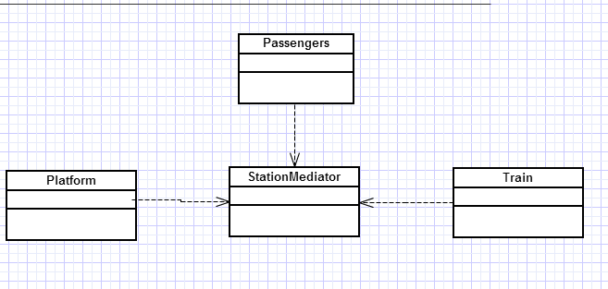
Mediator Design Pattern
Railway station has 2 platforms
A train can only come into the station if the platforms are free
The communication between the platform-station and the trains can be mediated
“Removes direct dependency between objects”

Slide 47
References
  http://en.wikipedia.org/wiki/Design_Patterns
  Head First Design Patterns
  http://www.vogella.com/articles/DesignPatterns/article.html

